Slide 1


Internal Business Analysis
Assignment 3

Slide 2
Content Table:
SWOT analysis for Financial Education Crew
Porter’s Value Chain for Medicals International
BCG Analysis for Dangote Group.

Slide 3

SWOT Analysis
Strengths
Weaknesses
Opportunities
Threats

Slide 4
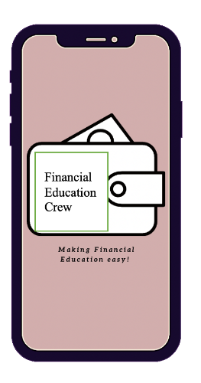
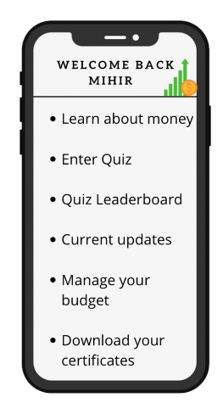
SWOT analysis for Financial Education Crew
Log in
Multiple options available in the menu bar
- Financial concepts videos. - Advance courses.
- Budgeting feature - Latest updates
- Quiz - Lead board - Certificate download
Reward Points for top place on the quiz and referring the app.
Checkout

Slide 5




SWOT analysis for Financial Education Crew
Fun Interactive Course
Patent on course and ancillary material
Qualified and professional team
User friendly application
Small operations team
Small number of Marketing or customer acquisition team
Low availability of funds compared to competition
Strengths
Weaknesses
New education policy
No available workbooks in the market
Less competition targeting working people professionals
Low number of professional financial educators
Demand for financial educators from local government and NGOs
Competitors like JUNIO
Free YouTube Finance bloggers
Change in taxation or economic policies
Opportunities
Threats

Slide 6




SWOT analysis for Financial Education Crew
Create workbooks with the patented course and target finance graduates.
Apply for funds from finance companies as part of their CSR initiatives.
Collaborate with NGOs and local governments.
Explore partnerships with schools and universities.
Create a YouTube channel with basic financial education and a forward link to download the app and get advanced materials by subscribing
Set up a one-man research team to stay updated on any changes and adapt the course materials accordingly
Leverage social media platforms
Notes:
maxi maxi part: (Strengths +Opportunities - SO):
we have identified an opportunity to create workbooks with the patented course and target finance graduates to become part of the network to reach more segments. This can help to address the weaknesses of a small operations team, a small marketing team, and low availability of funds compared to the competition.
maxi mini part (Strengths +Threats- ST):
we have identified a threat of competitors like JUNIO and free YouTube finance bloggers, and proposed a solution to create a YouTube channel with basic financial education and a forward link to download the app and get advanced materials by subscribing. This can help to leverage the strengths of the fun interactive course and user-friendly application, while addressing the threat of competition.
mini maxi part (Opportunities +Weaknesses- OW):
we have identified an opportunity to apply for funds from finance companies as part of their CSR initiatives, while also addressing the weakness of low availability of funds compared to the competition and the opportunity of a new education policy and demand for financial educators.
Collaborate with NGOs and local governments: Since there is a demand for financial educators from local governments and NGOs, it might be worth exploring opportunities to collaborate with them to offer financial education programs for the target segments. why is it in the mini maxi part: it addresses the weakness of low availability of funds compared to the competition and the opportunity of demand for financial educators from local governments and NGOs.
Explore partnerships with schools and universities: As the startup offers financial education for students over 10 years of age, it might be useful to explore partnerships with schools and universities to offer the course as a part of their curriculum. This can help to increase the reach of the startup while also addressing the weakness of a small marketing team. why is it in the mini maxi part: it addresses the weakness of a small marketing team and the opportunity of targeting students as a potential customer segment.
mini mini part (Threats +Weaknesses- TW):
we have identified a threat of changes in taxation or economic policies, and proposed a solution to set up a one-man research team to stay updated on any changes and adapt the course materials accordingly.
Leverage social media platforms: In addition to creating a YouTube channel, it might also be useful to leverage other social media platforms such as Instagram and Facebook to promote the startup and engage with potential customers. This can help to address the threat of free YouTube finance bloggers and increase brand awareness. why is it in the mini mini part: it addresses the threat of free YouTube finance bloggers and the weakness of a small marketing team.
Overall, our mini-maxi SWOT analysis provides a good starting point for identifying strategic initiatives that can help the Financial Education Crew startup leverage its strengths and opportunities, while addressing its weaknesses and threats.

Slide 7
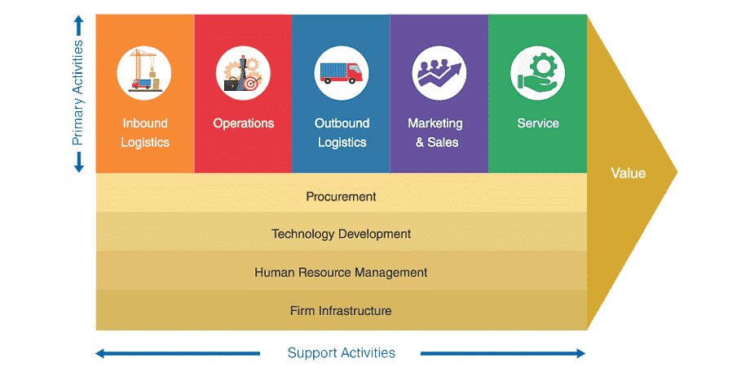
Porter’s Value Chain

Slide 8

Porter’s Value Chain
Medicals International is a company that specializes in the supply and distribution of medical and laboratory equipment, instruments, and supplies. They offer a wide range of products, including medical imaging equipment, surgical instruments, laboratory analyzers, and diagnostic tools, among others.
The company serves various healthcare providers, including hospitals, clinics, laboratories, and research institutions, and operates in multiple countries worldwide. Medicals International prides itself on providing quality products from reputable manufacturers and ensuring customer satisfaction through timely delivery and exceptional customer service. They aim to improve the quality of healthcare by providing reliable, innovative, and cost-effective solutions to their clients.

Slide 9





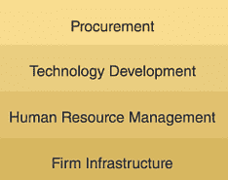
Porter’s Value Chain For Medicals International
Off-shore Staff: negotiate favorable terms with their suppliers to ensure they get quality products at a reasonable price
Sales team: visit potential and old clients
Inventory Managers: effective inventory management
Service Engineers: provide support and advice to clients
Delivery officers: make sure that products are delivered to clients in a timely and efficient manner
Account Managers: follow up on orders and payments for clients. Be the link between the customer service, sales, collection officers and accounting.
Notes:
Medicals International is a company that sells medical equipment and supplies. Here is an analysis of their value chain based on Porter's model:
Inbound logistics: Medicals International would need to source their medical equipment and supplies from various suppliers. They would need to negotiate favorable terms with their suppliers to ensure they get quality products at a reasonable price (off-shore staff, who are in contact with the companies) – Negotiate delivery terms and options.
Operations: Medicals International would need to ensure that they store, handle, and distribute their products efficiently. This would require effective inventory management (inventory managers), logistics management, and quality control (service engineers) processes to ensure that their products are in good condition when they reach their customers. – Inventory managers receive the shipment, then they count it, check to make sure it is up to quality standards, and distribute it as is needed.
Outbound logistics: Medicals International would need to ensure that their products are delivered to their customers in a timely and efficient manner (delivery officers). This would require effective distribution channels, transportation systems, and delivery networks to ensure that their products are delivered to their customers on time. Delivery officer receives directions from the office, checks that the packaging of the products is up to delivery safety standards, delivers the product to the customer and have the customer sign off that all is received properly.
Marketing and sales: Medicals International would need to promote their products to potential customers through various marketing (digital, pamphlets and events (conferences)) and sales channels (sales team that visits potential customers). This would require effective marketing strategies and sales processes to attract and retain customers. The sales team work will be explained thoroughly in the next slide.
Service: Medicals International would need to provide effective after-sales service to their customers to ensure customer satisfaction (customer service agents). This would require effective customer service processes to handle customer queries and complaints, and to provide support and advice to their customers (Service engineers).
Support Activities: Collection officers to receive payments from customers. Account Managers: they follow up on orders and payments for customers. Country Managers working as support (Human Resource tasks). Collection officer receive weekly updates from accounting as to what needs to be collected, call and visit customers to inform them of their balance, collect weekly payments, then deliver payments to accounting and update them.
Overall, Medicals International's value chain would involve managing their inbound logistics, operations, outbound logistics, marketing and sales, and service processes effectively to ensure that they provide high-quality products and services to their customers at a reasonable cost.

Slide 10
Porter’s Value Chain For Medicals International
Acquire comprehensive knowledge of all available products
Conduct territory mapping to identify potential clients
Conduct research on competitors to gain a competitive edge
Establish a schedule for visiting potential clients
Provide daily reports on market activities
Respond to client comments and inquiries in a timely manner
Submit orders to the office once confirmed by the client
Develop contractual agreements between the company and clients
Follow up with clients on product usage and satisfaction
Coordinate with the service team for annual check-ups or as requested by clients.
Notes:
Further breakdown of the Sales team’s activities
Acquire comprehensive knowledge of all available products
Conduct territory mapping to identify potential clients
Conduct research on competitors to gain a competitive edge
Establish a schedule for visiting potential clients
Provide daily reports on market activities
Respond to client comments and inquiries in a timely manner
Submit orders to the office once confirmed by the client
Develop contractual agreements between the company and clients
Follow up with clients on product usage and satisfaction
Coordinate with the service team for annual check-ups or as requested by clients.

Slide 11




BCG Analysis
Question Mark
Star
Market Growth
Cash Cow
Dog
Relative Market Share

Slide 12

BCG Analysis For Dangote Group
The Dangote Group is a Nigerian multinational industrial conglomerate in West Africa and one of the largest in Africa and one of the largest on the African continent. The group employs more than 30,000 people, generating revenue in excess of USD 4.1 billion in 2017.
Portfolio:
Dangote Sugar
NASCON
Dangote Flour Mills Plc
Steel
Dangote Oil and gas
Packaging
Dangote Cement

Slide 13
BCG analysis for Dangote Group
NASCON & Dangote Cement
Dangote Oil and Gas
Dangote Steel (Metal & Mining)
Market Growth
Dangote Sugar
Dangote Flour Mills
Relative Market Share
Notes:
The Dangote Group is a Nigerian multinational industrial conglomerate in West Africa and one of the largest in Africa and one of the largest on the African continent. The group employs more than 30,000 people, generating revenue in excess of USD 4.1 billion in 2017.
Portfolio:
Dangote Sugar
NASCON
Dangote Flour Mills Plc
Steel
Dangote Oil and gas
Packaging
Dangote Cement
1. Dangote Sugar:
Relative Market Share = 1.9 (HIGH)
Market Growth Rate = 3.5%. (LOW)
2. NASCON:
Relative Market Share = 2.5 (HIGH)
Market Growth Rate = 10.54% (HIGH)
3. Dangote Flour Mills Plc :
Relative Market Share = 0. (LOW)
Market Growth Rate = 3.8%(LOW)
4. Steel (Metal and Mining):
Relative Market Share = 0. (LOW)
Market Growth Rate = 10%(HIGH)
5. Dangote Oil and Gas:
Relative Market Share = 0. (LOW)
Market Growth Rate = 9% (HIGH)
6. Dangote Cement:
Relative Market Share = 2.7(HIGH)
Market Growth Rate = 10.02% (HIGH)

Slide 14
Emma Cohen - Ikenna Daniel Nwankwo - Lamis Salloum Yared - Rohan Upadhaya - Vaishnavi Pritam Veer
Thank You

